Slide 1


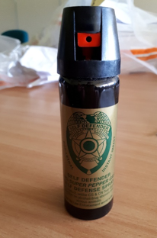
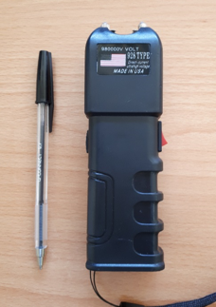
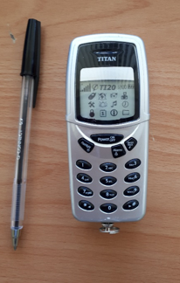
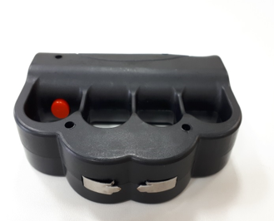
Think!
Police are aware of the laws around CS Spray, Stun Guns & Tasers but members of the public may not be…
National Firearms Surrender Saturday 20th July – Sunday 4th August 2019

